Slide 1
“ Personal Diary Management System ”
Presented by group: 07

Slide 2
Table Of Contents..!
01
02
03
04
05
Introduction
06
Add New Entry
11
Data Security
Project Goal
07
View & Search
12
Modular Design
System Architecture
08
Edit & Delete
13
Challenges
Flow diagram
09
Encrypt & Decrypt
14
Future Goal
User Interface
10
Backup System
15
Project Timeline
Presented by group: 07

Slide 3
1. Introduction..!
Overview:
PDMS, a secure digital diary application, is a console-based program designed for personal diary management.
Here's a breakdown of the features:
Console-Based Interface
Personal Diary Management
Security Focus
Simplicity and Efficiency
Md. Abul Bashar Nirob - 2022198042

Slide 4
2. Project Goal..!
Problem Statement:
Digital diaries lack privacy, organization, ease of use.
Existing apps may not allow full user control.
Solution:
Encryption for security.
Modular design for scalability.
Local storage for user control.
Md. Abul Bashar Nirob - 2022198042

Slide 5
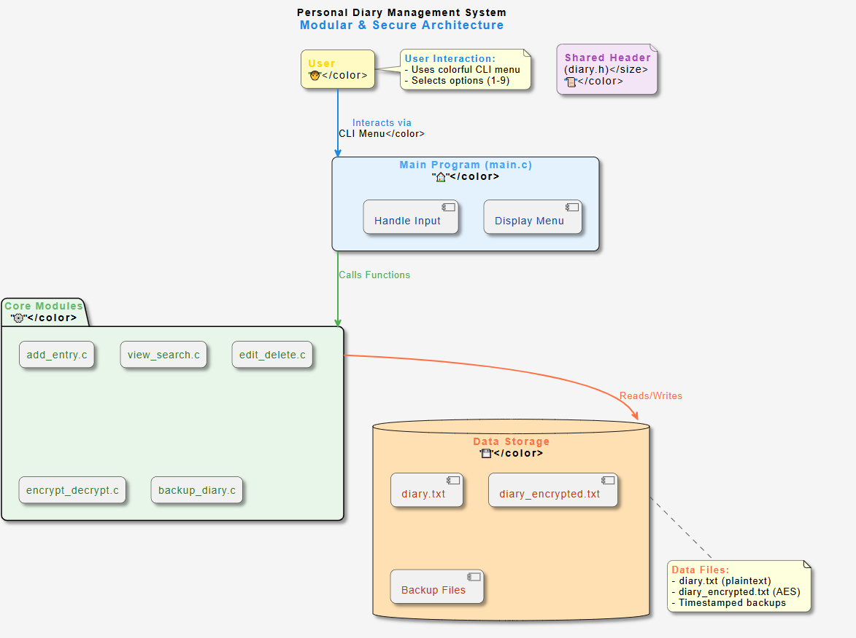
3. System Architecture..!
Diagram Contains:
User Input → Main Menu (main.c)
Feature Modules (add, view, edit, encrypt, backup)
Data Storage (File I/O with encryption)
Md. Abul Bashar Nirob - 2022198042

Slide 6
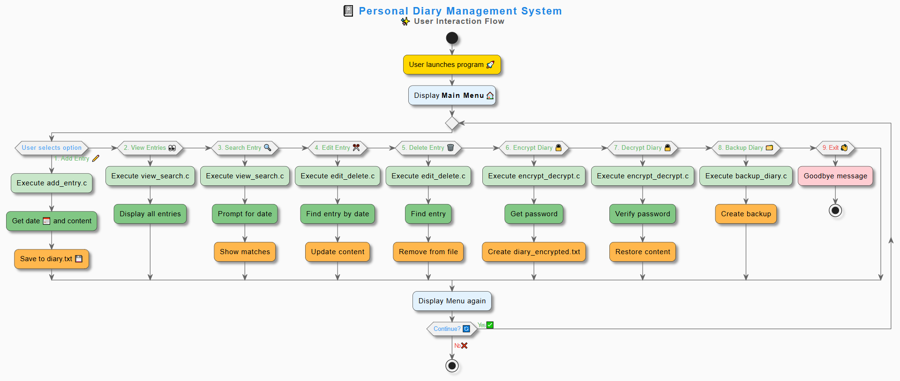
4. Flow diagram..!
Md. Abul Bashar Nirob - 2022198042

Slide 7
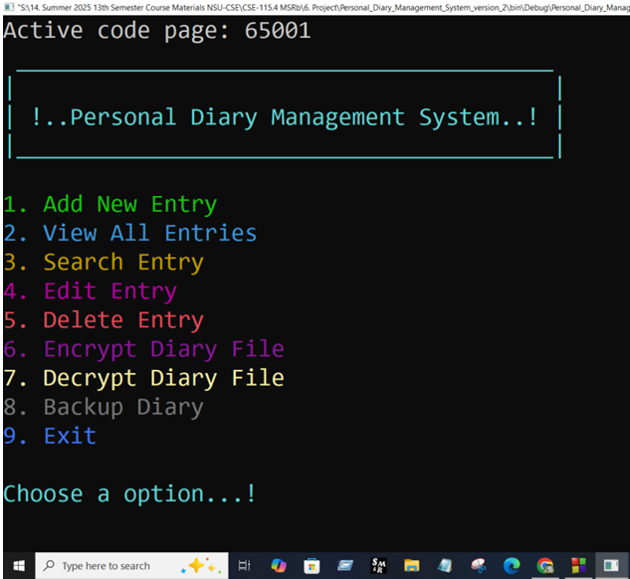
5. User Interface..!
Features:
Add new diary entries with dates
View all entries or search by date
Edit existing entries
Delete unwanted entries
Secure encryption with password protection
Automatic timestamped backups
Tashin Binte Taiba - 252 2283 642

Slide 8
6. Add New Entry..!
Functionality:
Appends new entries to "diary.txt" file
Stores both date and entry content
User-friendly prompts
Error handling for file operations
Clear success message after saving
Features
Users
Updates
Tashin Binte Taiba - 252 2283 642

Slide 9
7. View & Search..!
View All Entries:
Reads and displays entire diary file
Formatting for better readability
Search Entries:
Linear search through file contents
Clear indication when no matches found
Displays complete matching entries
Tashin Binte Taiba - 252 2283 642

Slide 10
8. Edit & Delete..!
Functionality:
Finds entries by date
Allows modifying entry text
Uses temporary file for safe updates
File handling with error checking
User confirmation before changes
Q1
Q2
Q3
Q4
Tasnia Afrin - 2523855642

Slide 11
9. Encrypt & Decrypt..!
Security Features:
XOR-based encryption with password
Password length verification
Header validation
Decryption Safety Checks:
Password length matching
Content structure verification
Temporary memory decryption
Sara Tasnim - 2522727042
Tasnia Afrin - 2523855642

Slide 12
10. Backup System..!
Backup Functionality:
Creates timestamped copies
Automatic filename generation
Benefits:
Data protection against accidental loss
Historical record of entries
Simple file copy operation
Tasnia Afrin - 2523855642

Slide 13
11. Data Security..!
Why Encryption?
Prevents unauthorized access.
Even if files are stolen, data is secure.
How It Works:
User sets a password → key derives encryption.
Data encrypted before saving to file.
Sara Tasnim - 2522727042

Slide 14
12. Modular Design..!
Why Modular?
Easy debugging
Scalable (add features later)
Clean code separation
Key Files:
diary.h (Header – central config)
main.c (Core logic)
Feature modules (add_entry.c, encrypt_decrypt.c, etc.)
Sara Tasnim - 2522727042

Slide 15
13. Challenges & Solutions..!
Development Challenges & Solutions:
Security Risks: Unauthorized access → AES-256 encryption
Data Loss: File crashes → Timestamped backups
User Inputs: Bad formats → Input validation
Code Structure: Hard to debug → Modular design
Search Speed: Slow lookups → Date indexing
Sara Tasnim - 2522727042

Slide 16
14. Future Improvements..!
Near Future?
GUI Version (GTK/Qt)
Cloud Sync (Optional)
Mobile Port (Android/iOS)
Jannatul Islam Eshita - 2524186042

Slide 17
15. Time line of PDMS..!
Week 1: Project Setup & Core Architecture
Week 2: Core Functionality Implementation
Week 3: Search & Edit Features
Week 4: Security Implementation
Week 5: Backup System & Error Handling
Week 6: UI Enhancements
Week 7: Testing & Debugging
Week 8: Documentation & Finalization
Jannatul Islam Eshita - 2524186042

Slide 18
Thanks..!
Do you have any questions then feel free to ask or?
abul.nirob@northsouth.edu
01404389002
Please keep this slide for attribution
Jannatul Islam Eshita - 2524186042

